Slide 1

Getting Started with Federated Learning using Flower & PyTorch
Build a cross-silo federated learning system where multiple organizations collaboratively train a CNN on CIFAR-10 without sharing raw data. Learn to implement privacy-preserving machine learning with Flower's intuitive framework.

Slide 2

Environment Setup & Project Structure
Installation Steps
Generated Files
Install Flower with simulation extras
The template creates a complete project structure:
Create project from template
client_app.py - Client logic
Install project dependencies
server_app.py - Server orchestration
task.py - Model & data definitions
pip install -U "flwr[simulation]"
flwr new @flwrlabs/quickstart-pytorch
pip install -e .
pyproject.toml - Dependencies

Slide 3




Defining the Task: Data & Model
CIFAR-10 Dataset
CNN Architecture
Training Functions
Flower Datasets partitions CIFAR-10 across clients, simulating multiple organizations each holding private data subsets.
A simple convolutional neural network defined with torch.nn.Module for image classification tasks.
Standard PyTorch train() and test() functions in task.py handle local model training and evaluation loops.

Slide 4

The Flower Client: Local Training
01
02
Receive Global Model
Train Locally
Client receives a Message containing current global model weights from the server.
The @app.train() decorator defines training on local data partition using private dataset.
03
04
Return Updates
Evaluate Performance
Send back updated weights as ArrayRecord and training metrics like loss as MetricRecord.
The @app.evaluate() function validates model performance on local validation data.
Key Concept: Clients never share raw data—only model updates are transmitted, preserving privacy while enabling collaborative learning.

Slide 5





Server Orchestration & Federated Flow
Server Configuration
Broadcast Parameters
The @app.main() function initializes the federated learning process:
Server sends global model to selected clients
Initialize global model parameters
Configure FedAvg strategy for aggregation
Local Training
Set client participation fraction
Clients train on private data and compute updates
Define number of training rounds
flwr run
Aggregate Updates
Server averages client updates using FedAvg strategy
Iterate Rounds
Repeat for configured number of rounds

Slide 6
System Setup & Environment
Frameworks & Tools
Configuration
Flower (Simulation Engine)
Dataset: CIFAR-10 (Image Classification)
Flower Datasets
Data Partitioning: IID (Independent and Identically Distributed) across 10 Clients using IidPartitioner
PyTorch
Ray (for concurrency)
Device Constraint: CPU training (torch.device("cpu")) for stability in Google Colab environment

Slide 7
Model Architecture & Strategy
CNN Architecture (Net class)
Federated Strategy
2 Convolutional layers with ReLU activation and Max Pooling
Strategy: FedAvg (Federated Averaging)
Client Participation: 100% of clients sampled for fitting and evaluation in every round
3 Fully Connected (Linear) layers
Designed for CIFAR-10 image classification
Parameters: fraction_fit=1.0, min_fit_clients=10
Aggregation: Custom weighted average function based on example counts

Slide 8

Simulation Execution
Configuration:
Simulation ran for 3 Rounds
10 Virtual Clients
01
02
Dependencies installed
start_simulation initiated
Specific fix for protobuf and grpcio versions
With 10 Virtual Clients
03
04
Local training
Weights aggregated
Each client trained locally for 1 epoch
Server aggregated weights after every round
Runtime:
Total simulation time: approximately 107 seconds

Slide 9
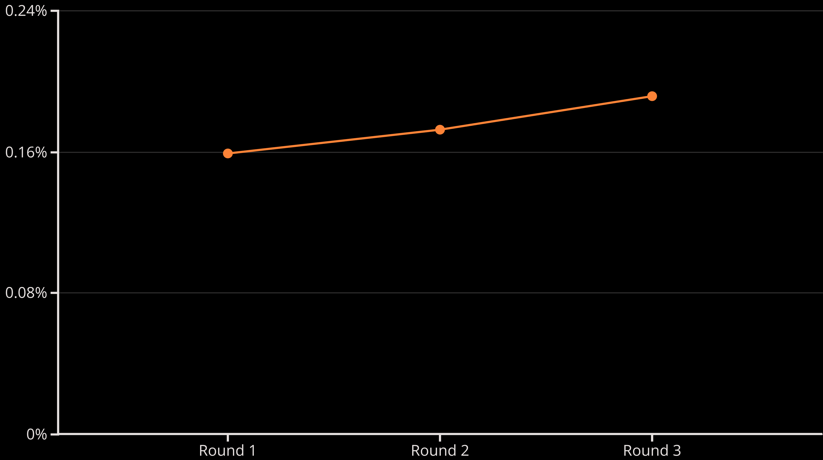
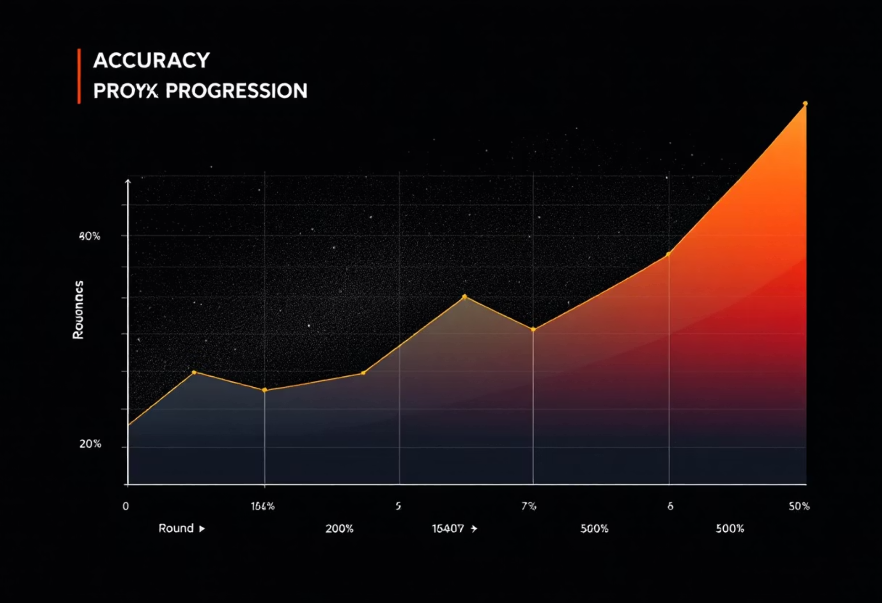
Results & Visualization
Here are the key accuracy metrics achieved across the federated learning rounds:
15.89%
17.26%
19.14%
Round 1 Accuracy
Round 2 Accuracy
Round 3 Accuracy (Final Result)
The chart below illustrates the progression of model accuracy over the three federated learning rounds, clearly demonstrating an upward trend in performance.

